Slide 1
Fedora and RISC-V
David Cantrell
Principal Software Engineer
Red Hat
Fedora Council and FESCo member

Slide 2
DISCLAIMER: This is not my presentation!
This session was proposed by Isaac Chute of The Linux Foundation. Isaac is the Director of RISC-V Software Ecosystem.
Isaac could not make it to Flock and asked me if I could give the presentation instead.
I do not work on RISC-V things as part of my day job. I am on the Fedora Council and FESCo and at Red Hat I am part of the Software Management team where I work on dnf, rpm, and software adjacent to those tools.
RISC-V is interesting to me so I hope I can give a perspective from a long time Linux developer watching this ecosystem grow.
Please hold all questions until the end.
dcantrell@redhat.com

Slide 3
Agenda
What is RISC-V (brief)
Red Hat position on RISC-V
Short Term Planning - Fedora
Evolutionary Next Steps

Slide 4
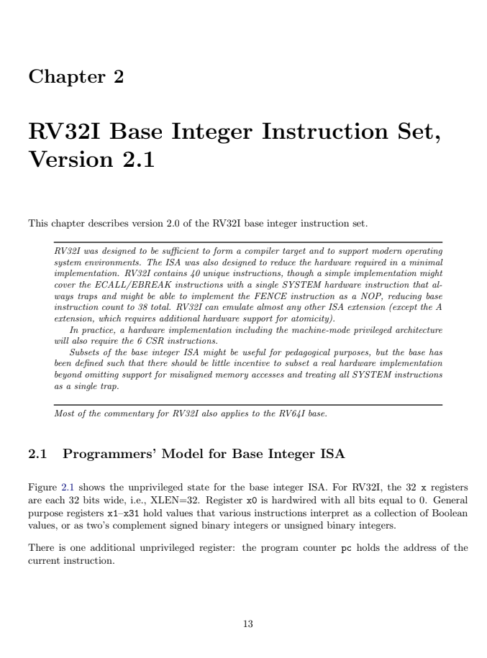
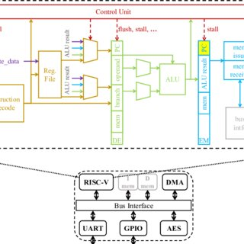
Open Standard RISC Instruction Set Architecture
Next Generation of RISC - reduced instruction set computing makes up a huge proportion of current architectures, including RISC-V, Arm, and PowerPC
Open Instruction Set Architecture - ISA initially developed at UCB as the 5th generation of RISC, published with a Creative Commons license, enables both open and proprietary hardware designs
Open Process - the RISC-V development community is made up of thousands of developers and hundreds of companies globally, all working collaboratively in a global foundation (riscv.org) using best practices for open standards
dcantrell@redhat.com

Slide 5
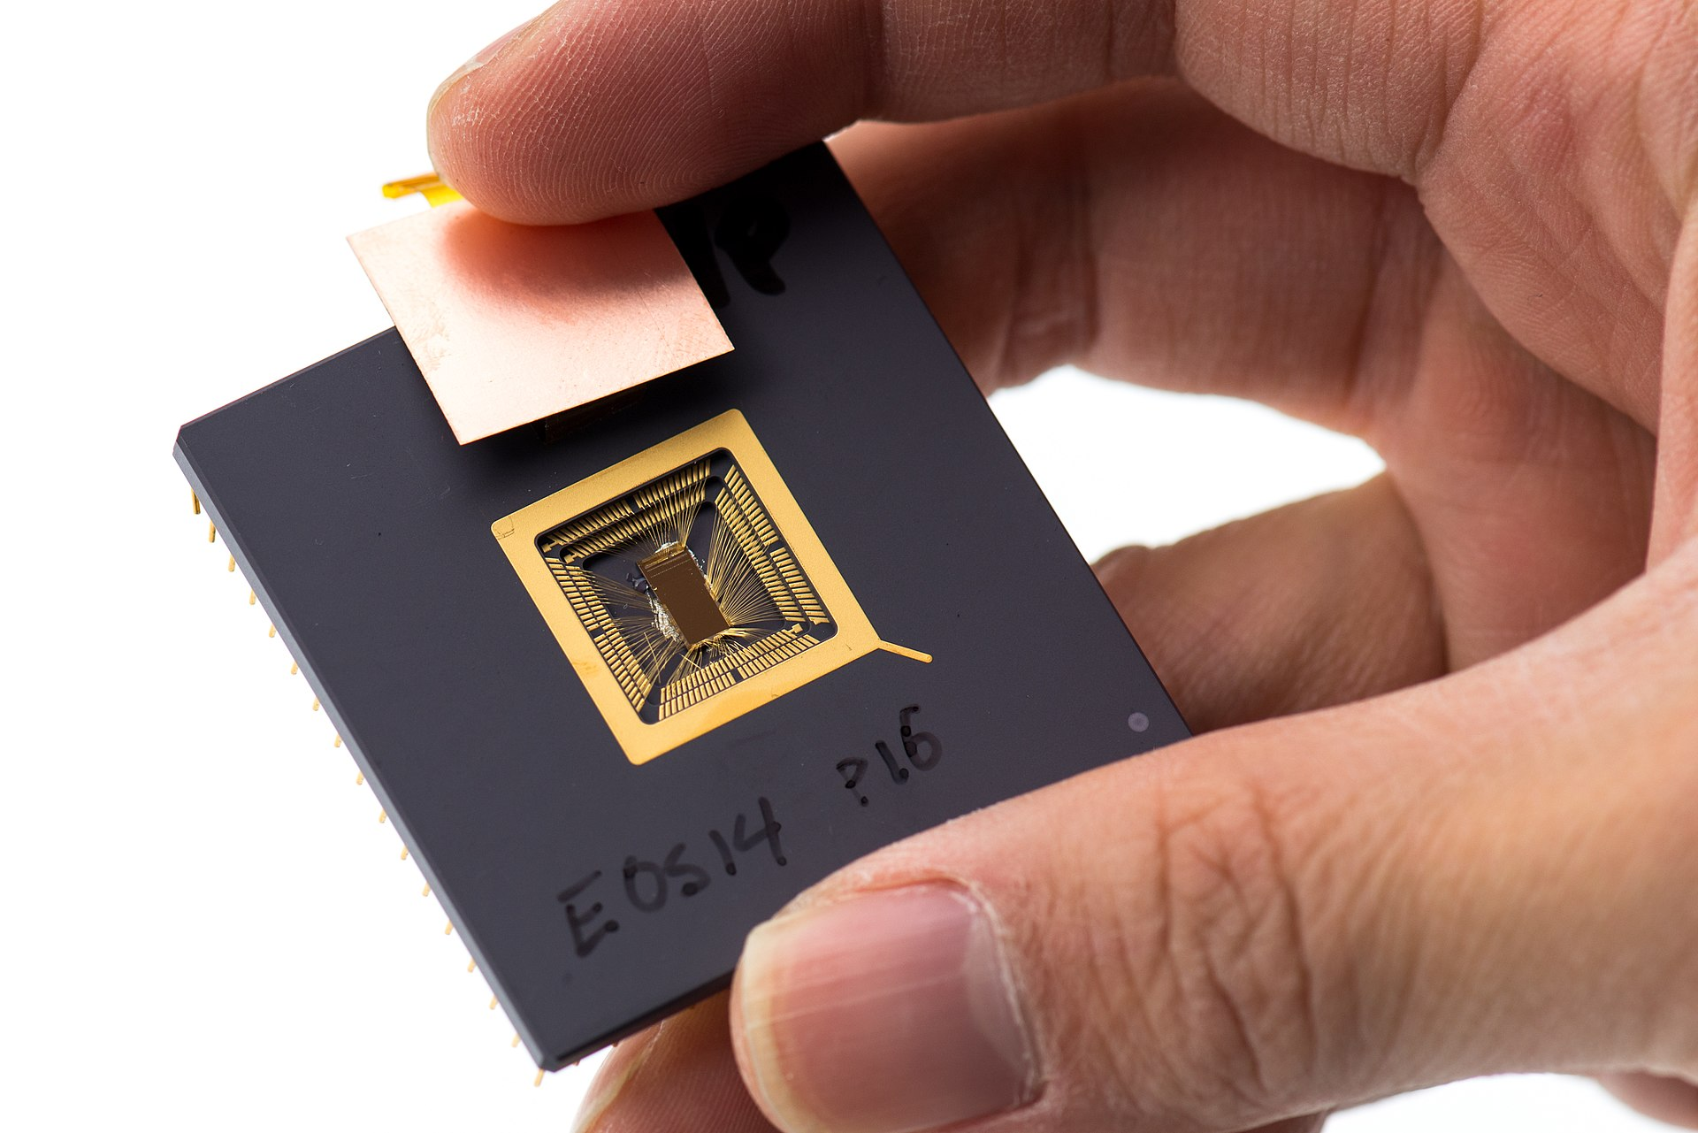
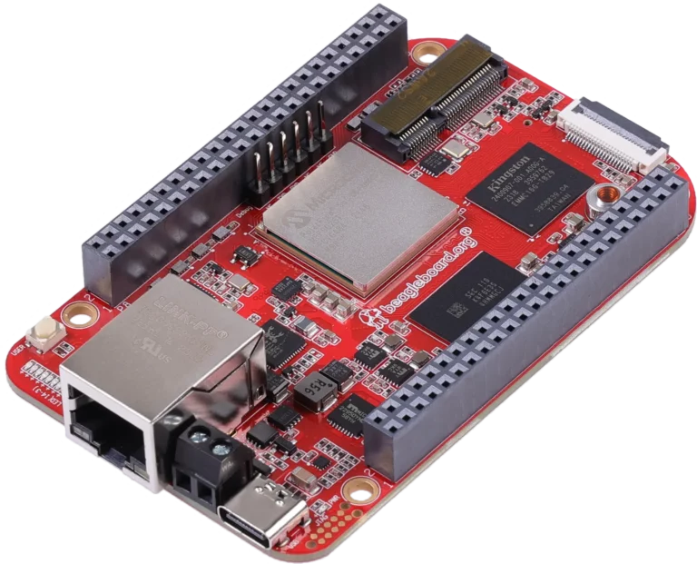
Red Hat’s position on RISC-V: Not If, but When
RISC-V represents the first commercial successful implementation of an open Instruction Set Architecture (ISA)
Many cores available, both open and closed - the ISA copyright terms and IPR policies enable both fully open and completely proprietary designs
Some companies take it seriously - Western Digital converted its entire line of disk controllers to RISC-V in 2019, NVIDIA ships 8-12 RISC-V cores on every board, expected 92B TAM by 2030
Very popular globally - RISC-V development and production is roughly evenly spaced among Europe, Asia, and the Americas, with the organization RISC-V International based in Switzerland
dcantrell@redhat.com

Slide 6
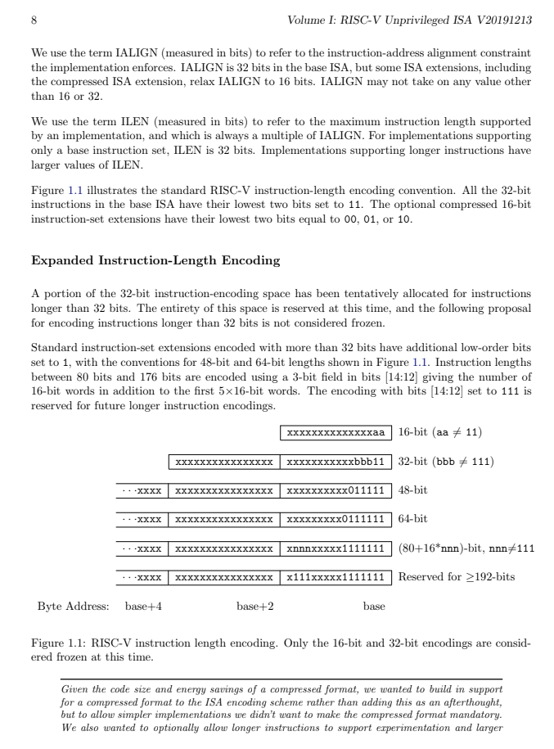
Red Hat’s position on RISC-V: Not If, but When
RISC-V Hardware and Software Ecosystem growing quickly
RISC-V Technical Working Groups - member-driven primary ISA development, curated by RISC-V Int’l
RISC-V Discussion Groups - open Google Groups and Slack channels for technical discussions about RISC-V, private working groups within RISC-V for ISA development
OpenHW Group - open hardware cores based on RISC-V
CHIPS Alliance - open hardware cores, interconnects, and development tools
dcantrell@redhat.com

Slide 7
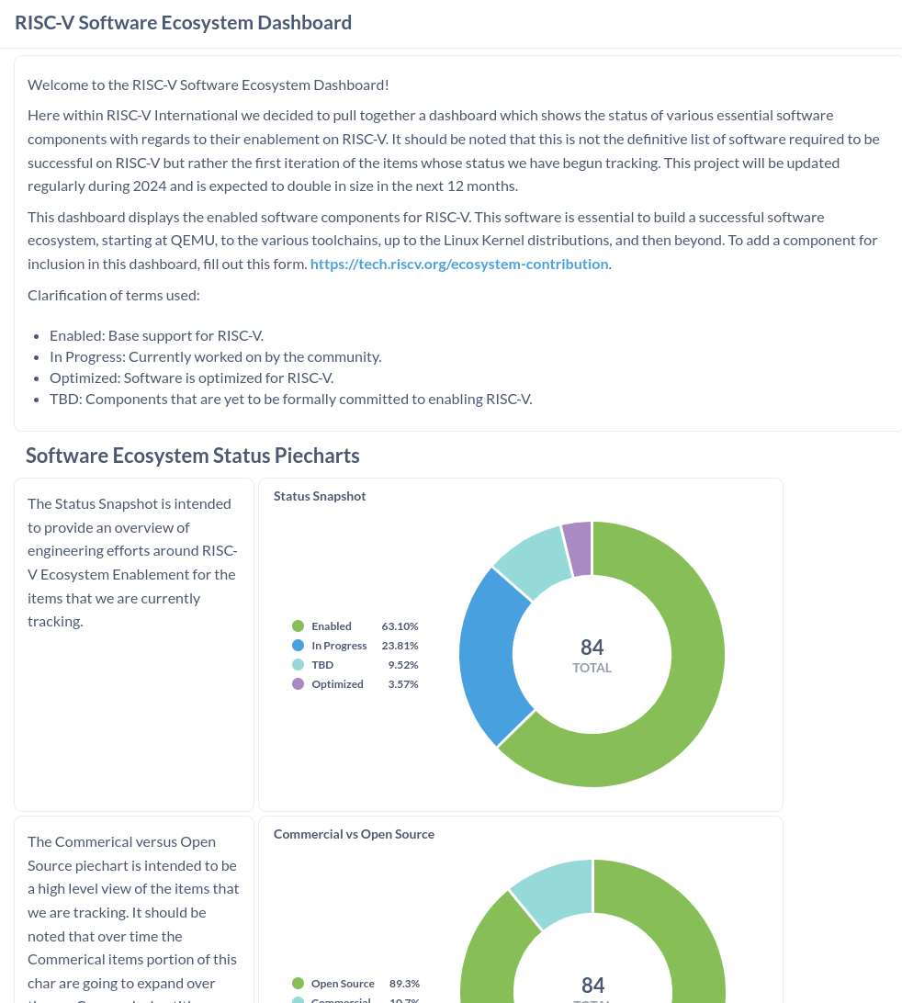
Red Hat’s position on RISC-V: Not If, but When
RISC-V Standardization
Hardware and ISA standardization - ‘Optional’ hardware support for features like vector/crypto is hard to reflect up into libraries or workloads. We would like to see crisp definitions for ISV versions.
Defined profiles & platforms with minimum configurations The work to define the spec standards (eg. RVA23) and minimum HW configuration for different usage models (Server, Virt, Embedded etc) is key to adoption
Hardware and ISA standardization - In general, Red Hat doesn't support vendors specific ISA extensions, despite enthusiasm from the HW vendors
dcantrell@redhat.com

Slide 8
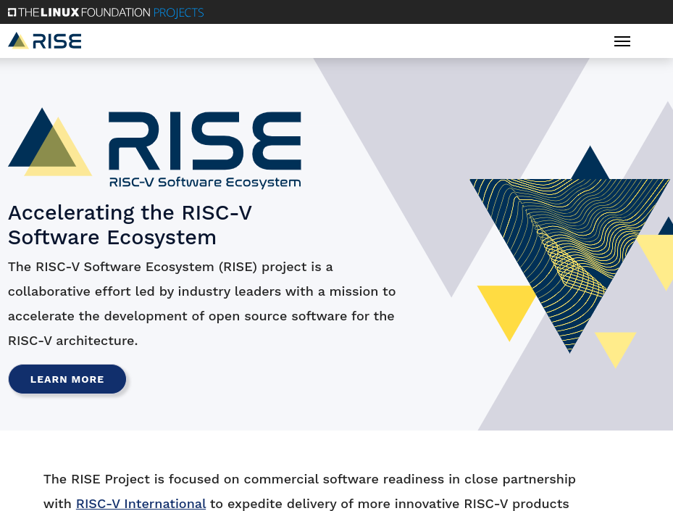
RISE is very important to Red Hat
Red Hat understands that software ecosystems need help
Founding member of the RISE Project, which provide engineering and financial support for upstream projects to invigorate the RISC-V software ecosystem
Red Hat chairs the Distro Integration working group within RISE, focused on Linux and other binary distros, including Fedora
Red Hat also chairs the Outreach Committee and serves on the RISE board as a voice for open source
dcantrell@redhat.com

Slide 9
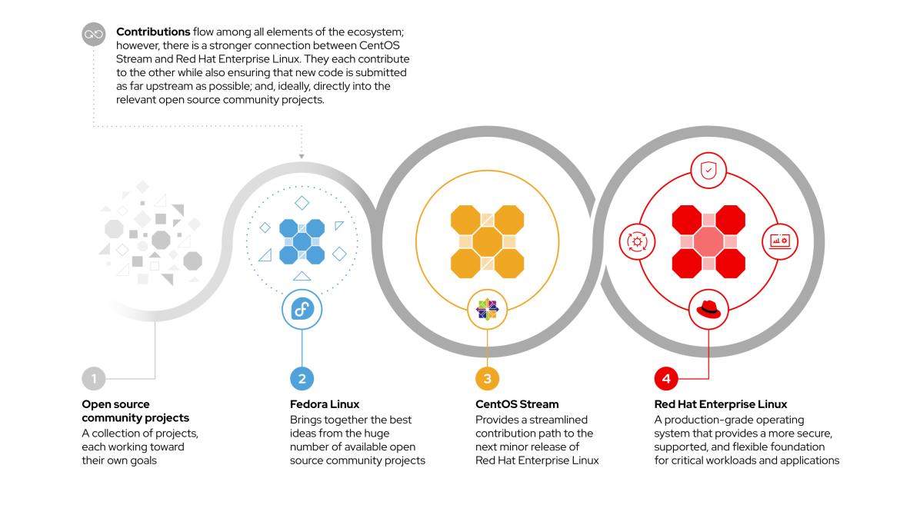
Red Hat technology evolution
dcantrell@redhat.com

Slide 10
Fedora Implementation
Fedora supports dozens of RISC-V platforms
Fedora 39 fully supported, Fedora 40 nearly all supported Fedora 41/rawhide 93% of packages
OCI image courtesy of Docker
Discussion groups on both Matrix and Fedora Discussions
Also supports the Sipeed Lichee processors and laptop, the BeagleV-Ahead, Milk-V Pioneer, and many other development boards and systems
https://fedoraproject.org/wiki/Architectures/RISC-V
dcantrell@redhat.com

Slide 11
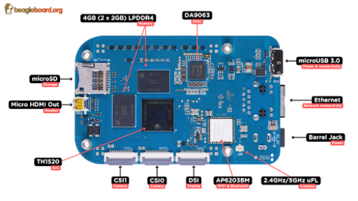
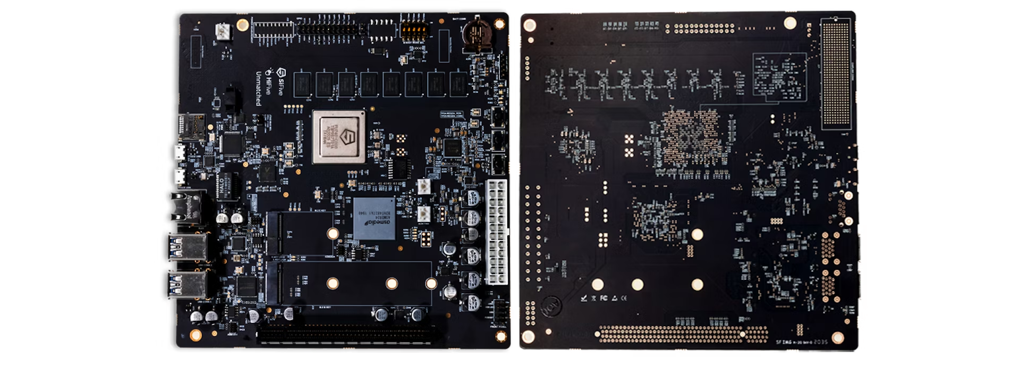
Fedora Implementation
Fedora + RISC-V - Fedora RISC-V page, Fedora RISC-V Installing page, riscv.rocks koji, OCI image, kernel build page, Fedora Discussions, Matrix
Red Hat + RISC-V - DISL project, RISC-V Summit keynote, recent blog
RISC-V International - website, technical wiki, software dashboard, RISC-V Exchange, technical forums, specifications, dev boards program
RISE Project - website, technical wiki
OpenHW Group - website, Fedora + CVA6 demo
CHIPS Alliance - website
dcantrell@redhat.com

Slide 12
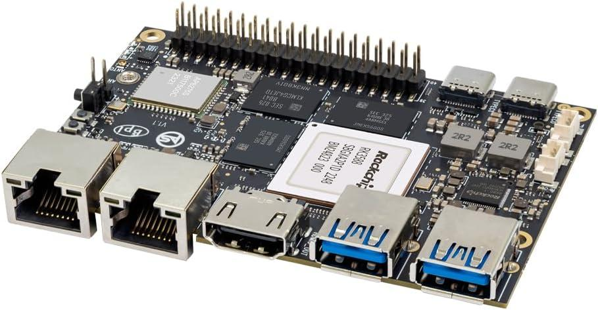
Evolutionary Next Steps
RISC-V ‘Data Center’ Hardware Availability
Hardware - The current wave of SBC/Development platforms don’t represent Enterprise Server design. This is not a criticism, just an observation of the current market. We have a distinct lack of developer platforms.
Server Definition - A standard definition of the minimum RVV + Extensions, plus minimum hardware specification doesn't yet exist. We have confidence it is forthcoming!
Until Enterprise Server hardware designs begin to become available and a Server has a RISC-V specification of a minimum HW configuration, Fedora will remain as the Red Hat Flagship.
dcantrell@redhat.com

Slide 13
Thank You
dcantrell@redhat.com

